Slide 1
Autonomous Drone path Finder
Guide: Himanshu Sarma
Team (HS04):
Vanam Hemanth (S20170010172)
Neelakanta Sriram (S20170010102)
Puppala Hrithik (S20170010115)

Slide 2
Overview:
Introduction
Motivation
Problem statement
Objective
Scope
Literature review
Project plan
References

Slide 3
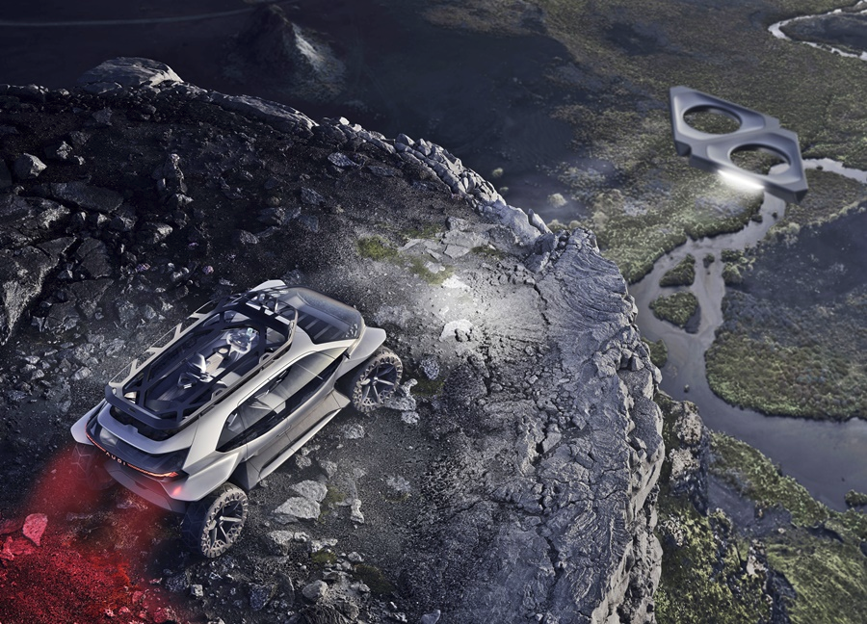
Introduction
Drones technology is booming in the coming years.
Drones are used in many fields such as in agriculture, construction, mining and many more.
Source: Audi concept car
Image link: https://www.piston.my/2019/09/21/audi-aitrail-quattro-brings-autonomous-driving-to-off-road-travels/

Slide 4
Motivation
We wanted to create a multi drone model which scouts the given area and creates a virtual map to provide navigation guidance to the user.
Few uses:
Trekking.
Search missions.
Aerial surveillance
Oil, gas, and mineral exploration

Slide 5
Problem Statement:
Simulate a Reinforced Learning drone model to create a virtual map of the current area by obtaining terrain information.

Slide 6
Objective
To create a Drone model Which creates flies around collecting terrain data from its sensors and create a map of the locality.
Sub Task:
Train the drone model to fly.
Train the drone model to explore new areas.
Train the drone to collect the data of the terrain.
Train the drones to work in collaborative environment.

Slide 7
Scope
Work on the simulation training part of the drone model.
Implement the simulation in diverse environments like urban city, indoor house, forest.
Implement multi drone model which all work in coordination with each other in an optimal fashion.

Slide 8
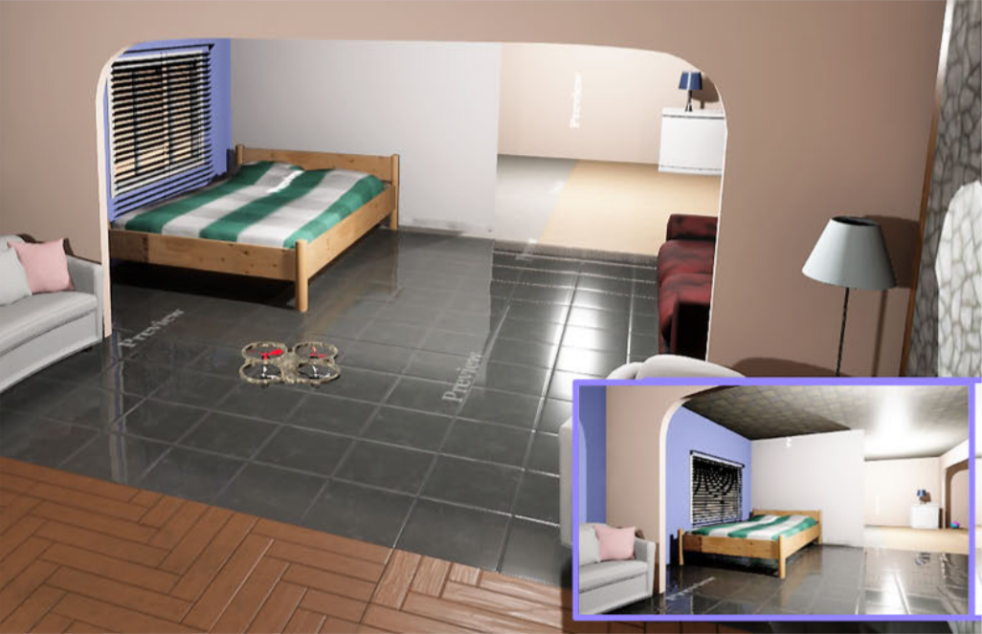
Literature Review
Reference: A. Anwar and A. Raychowdhury, "Autonomous Navigation via Deep Reinforcement Learning for Resource Constraint Edge Nodes Using Transfer Learning," in IEEE Access, vol. 8, pp. 26549-26560, 2020, doi: 10.1109/ACCESS.2020.2971172.
Autonomous collision free flight of a drone.
Unreal engine is used to create 3D realistic environments.
AirSim, an open source plugin that interfaces Unreal Engine with Python.

Slide 9
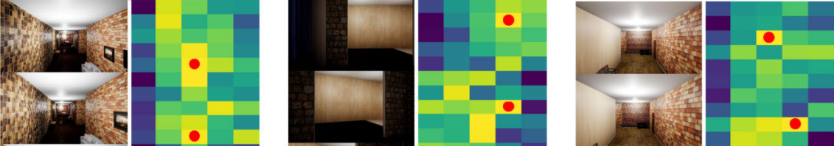
Literature Review (Cont...)
TL(Transfer Learning) is used, to reduce training latency while training in real environment.
In online phase, a parameter lastp(train type) is defined based on the number of layers that are trained.
Mean Safe Flight (MSF) was used to quantify the performance of the learned networks in the respective environment.

Slide 10
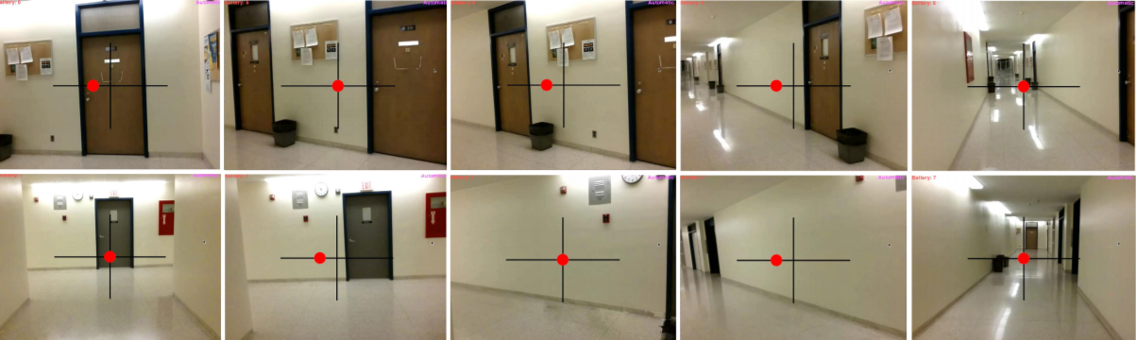
Literature Review (Cont...)
The approach was tested on a real environment using a low-cost drone and it showed similar performance when compared across different baselines.

Slide 11
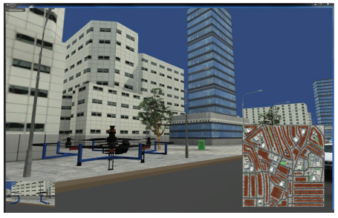
Literature Review
Reference : Yuchao Hu and Wei Meng , “ROSUnitySim : Development and experimentation of real-time simulator for multi-unmanned aerial vehicle local planning”, in Industrial Electronics Society, IECON 2015 - 41st Annual Conference of the IEEE, DOI: 10.1109/IECON.2015.7392488
Main Purpose is For Navigation and guidance of UAV in GPS Denied Environments .
In One Workstation , One or More UAV’s can be Simulated.

Slide 12
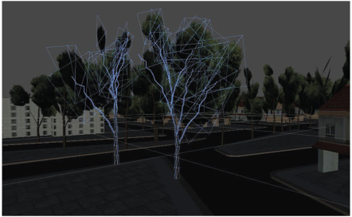
Literature Review
3D Environment Modelling
Mesh Determines the Visual Shape of Object and Collider is Used For Raycasting and Collision Detection .
Algorithms :
→ SLAM : Learns a Map and Locate the robot Simultaneously .
→ Path Planning is Made based On Occupancy grid . ( Uses info that is obtained from SLAM )

Slide 13
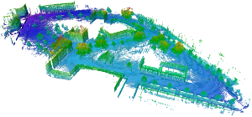
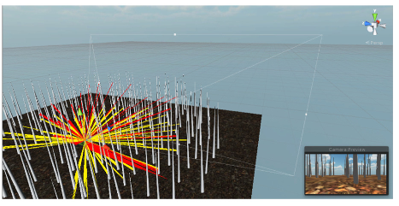
Literature Review
Octomap Conversion is Used to Represent the occupied areas and free spaces .
LiDAR Sensor is Used
Multi-Thread Programming is Used.
Control Logic nodes and Communicators are used in ROS for Planning and Collision Avoidance.
Image Credits (Upper) : https://octomap.github.io/

Slide 14
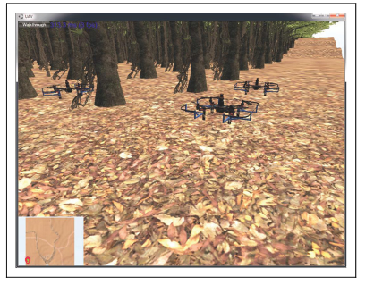
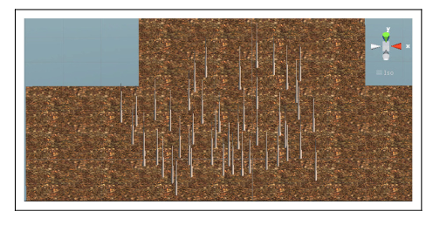
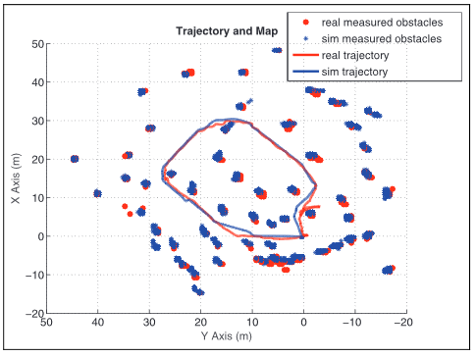
Literature Review
Results :

Slide 15
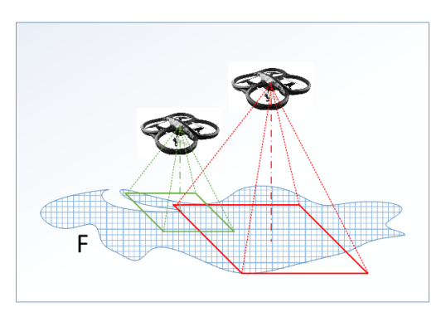
Literature Review
Reference: Huy Xuan Pham, Hung Manh La, David Feil-Seifer, and Ara Nefian, “Cooperative and Distributed Reinforcement Learning of Drones for Field Coverage”, arXiv:1803.07250v2 [cs.RO] 16 Sep 2018
Multi-Agent Reinforcement Learning (MARL) algorithm for a team of Unmanned Aerial Vehicles.
The complex problems:
The challenge in huge dimensional state space
The complex dynamic of the joint-actions of the UAV team.
Reinforcement Learning of Drones

Slide 16
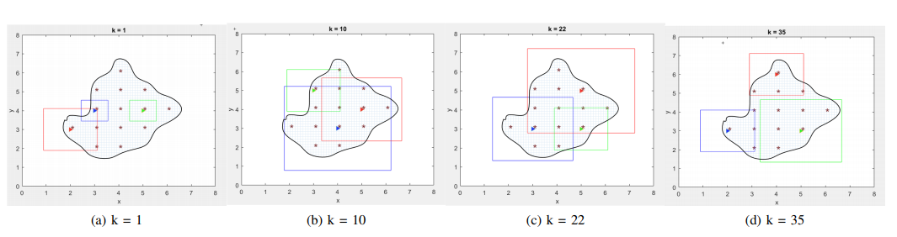
Literature Review
Q-Learning algorithm is applied on the drones.
Small reward for the agent when covering new area and huge reward for covering whole field of interest by all drones.
Negative reward when any two drones cover the same area.
Source: Leaning steps of drone simulation

Slide 17
Literature Review
Advantages:
UAV work in synchronous.
Less work for drones as work is distributed among other drones
Disadvantages:
As the actions depend on all drones states the Q table will be enormously huge in size.
As a result the training may take a long time.

Slide 18
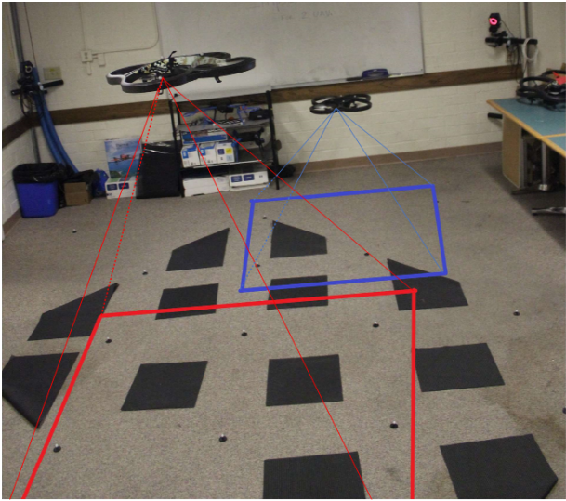
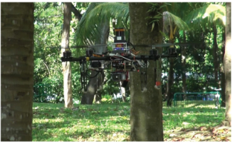
Literature Review (end)
All the papers have implemented their algorithm in simulation environment as well as in real world environment so there is a higher chance of drone model working in real world environment by following these papers.

Slide 19
Project plan
By the end of this semester : Make drone to fly and avoid obstacles
By mid evaluation of next semester : Make drone to generate virtual map
Final evaluation : Create multi agent model

Slide 20
References
Huy Xuan Pham, Hung Manh La, David Feil-Seifer, and Ara Nefian, “Cooperative and Distributed Reinforcement Learning of Drones for Field Coverage”, arXiv:1803.07250v2 [cs.RO] 16 Sep 2018.
A. Anwar and A. Raychowdhury, "Autonomous Navigation via Deep Reinforcement Learning for Resource Constraint Edge Nodes Using Transfer Learning," in IEEE Access, vol. 8, pp. 26549-26560, 2020, doi: 10.1109/ACCESS.2020.2971172.
Yuchao Hu and Wei Meng , “ROSUnitySim : Development and experimentation of real-time simulator for multi-unmanned aerial vehicle local planning”, in Industrial Electronics Society, IECON 2015 - 41st Annual Conference of the IEEE, DOI: 10.1109/IECON.2015.7392488

Slide 21
Thank You !!

